Slide 1
Unit – I
Introduction to Forensic Science
Ashna Bhatia
Research Scholar, NFSU

Slide 2

Forensic Science?
Forensic (?) + Science (?)
Forensic Science – an amalgamation of all sciences – used for judicial purposes.
The application of the methods, principles and techniques of the natural and physical sciences to matters of criminal and civil law (purpose of justice).
Identify, analyze, and compare the materials.
Establish the link b/w the crime, the criminal, the victim, the weapon of offence, the place and the time of occurrence.
It may be a simple identification of the presence of a criminal to the complicated profiling. (from obvious evidence to complex DNA, molecular biology etc.).
Multi-disciplinary field composed of many divisions and its units or subdivisions.

Slide 3
Introduction:
Forensic (Latin word) – meaning: of // before the forum.
The term originated from the Roman times – when criminal charges were meant to be presented before a group of public individuals in the forum. Both parties presented their cases and the judgement was based on the best of their arguments.
1835: Henry Goddard – Used physical matching to connect the bullet with the murder weapon.
1836: James March – Developed a chemical test to identify arsenic poisoning.
1853: Mathieu Orfilia – Detection of poisons// their effect on animals.
1892: The Chinese started fingerprints to ensure that business documents were authentic.
1896: Sir Edward Henry – Gave the Henry’s classification system.
1910: Edmond Locard – Father of FS// First police crime laboratory in France.
1930: Karl Landsteiner – Blood grouping system.

Slide 4
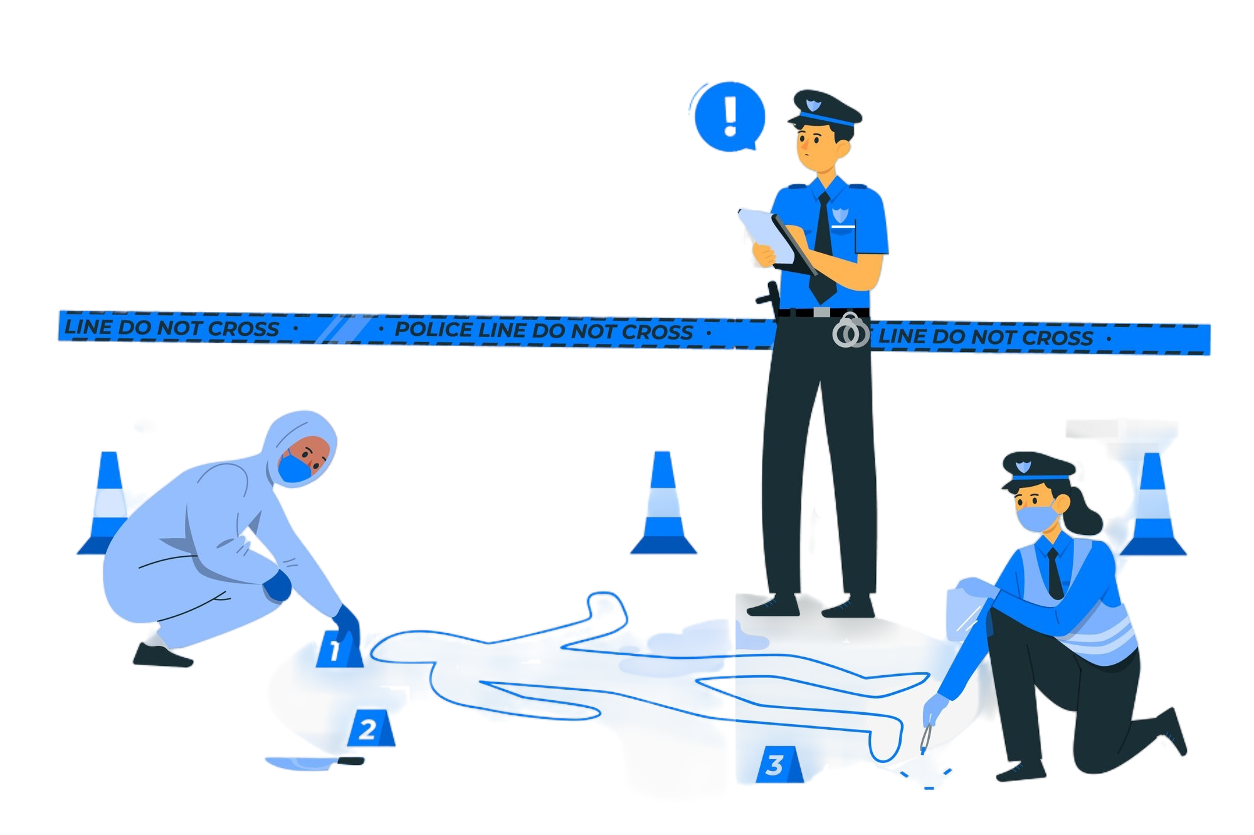
Nature and Scope of Forensic Sciences
Nature: Application of a broad spectrum of sciences to answer questions of interest to a legal system. This may be in matters relating to criminal law, civil law and regulatory laws. It may also relate to non-litigious matters.
Scope is everywhere where there arises a question of interest to a legal system.

Slide 5
2 Important Terms in Forensics
Corpus Delicti:
Corpus delicti is a Latin phrase that means “body of the crime” and is a common law principle in forensic science that’s important in criminal cases and investigations:
Explanation – It states that before someone can be charged with a crime, there must be enough evidence to prove that the crime occurred. This evidence can be in the form of a body or other forms, such as circumstantial evidence. The phrase “body” can refer to any kind of evidence, including the material substance upon which the crime was committed.
Purpose – The rule was established to prevent the government from punishing people for a crime based on a false or coerced confession.

Slide 6
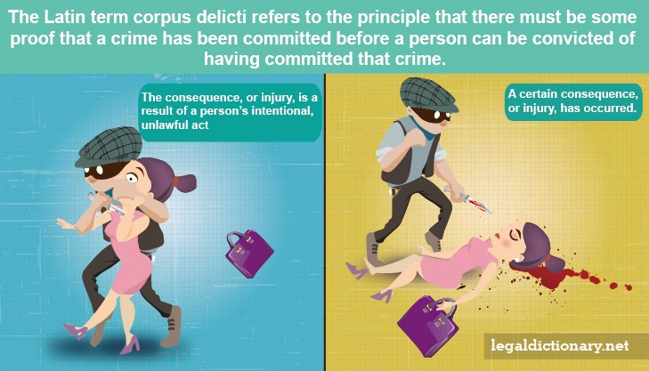

Slide 7
2 Important Terms in Forensics
Modus Operandi:
In forensic science, modus operandi (MO) is a Latin term that refers to the method of committing a crime, including the offender’s choices and behaviours.
It is a distinct pattern or manner of working that becomes associated with a particular criminal and is often so distinctive that it can be used to identify the same person as the perpetrator of separate crimes.
MO is an important part of crime reconstruction, crime scene analysis, and criminal profiling, and can help investigators identify, apprehend, and guide them to more certain evidence.
MO can include:
Acts and decisions that are necessary to commit a crime.
Any related choices made by an offender.
Learned behaviours that are dynamic and malleable.
For example, in a murder case where the assassin uses the same weapon and methodology, such as stabbing in the back, it shows that there’s only one perpetrator. MO can also be used as a basis for admitting evidence of other crimes.
For example, in a bank robbery case, evidence that the alleged robber was convicted of an armed robbery in the past could be admissible to prove identity through MO.

Slide 8


Slide 9
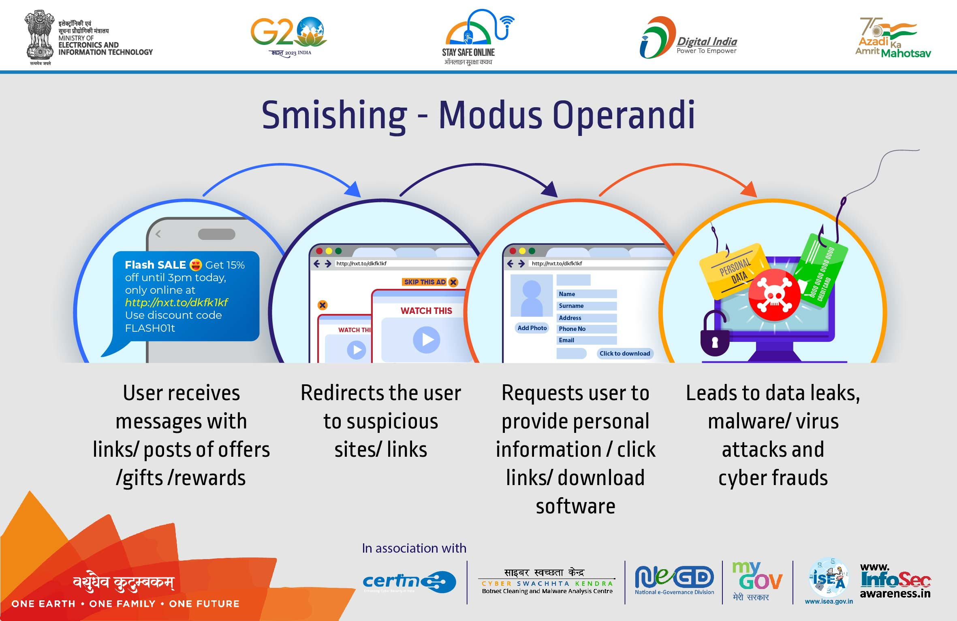

Slide 10
Forensic Science – The Concept
Based on Locard’s Principle of Exchange:
Whenever two objects - animate or inanimate, microscopic or macroscopic, in whichever physical state - come in contact with each other, there would be an exchange of materials and/or matters. (These materials and matters are known as Evidence).
Types of evidence:
Testimonial Evidence: Testimonial evidence is a statement or declaration made by a witness under oath, often used as evidence in legal proceedings.
Physical Evidence: Physical evidence is any tangible object or material that can be used to establish facts in a legal case, such as fingerprints, DNA, or weapons.
Trace Evidence: Trace evidence is small, often microscopic, material that can link a suspect to a crime scene, such as hair, fibres, or gunpowder residue.
Digital Evidence: Digital evidence is information or data stored or transmitted in digital form, used in legal cases, such as emails, computer files, or metadata.
Forensic science essentially deals with the laboratory examination of different types of evidence encountered at the crime scene.
Physical evidence is preferred over human evidence.

Slide 11
Basic Principles of Forensic Science
7 basic principles of Forensic Sciences
Law of Individuality (Every object is unique and individualistic).
Principle of Exchange (Every contact leaves a trace).
Law of Progressive change (Everything changes with the passage of time).
Law of Comparison (Only likes can be compared).
Law of Analysis (Analysis can be no better than the sample analyzed).
Law of Probability (Chances of occurrence of a particular event in a particular way out of a number of ways in which the event can take place).
Law of Circumstantial Facts (Facts do not lie, human can and do).

Slide 12

UNDER INVESTIGATION…

Slide 13
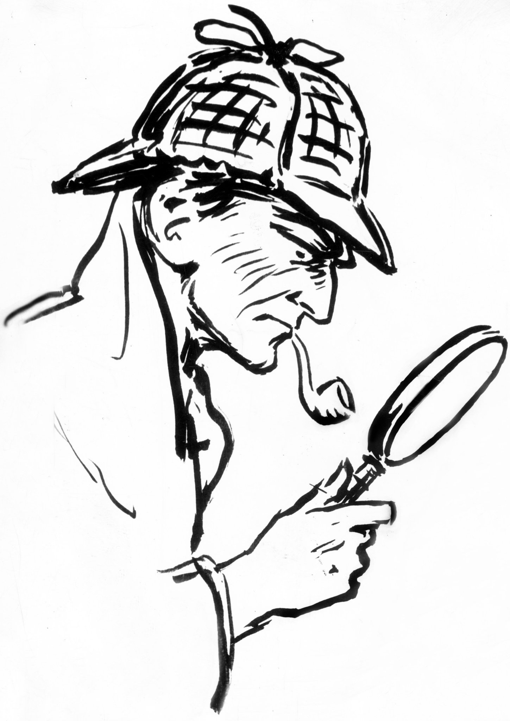
Sherlock Holmes?
Fictional character created by the Scottish writer Arthur Conan Doyle in 1887.
Arthur Ignatius Conan Doyle (1859-1930) was born in Edinburgh, Scotland. He worked as a surgeon on a whaling boat and also as a medical officer.
His first novel was published in Beeton’s Christmas Annual, under the title A Study in Scarlet which introduced us to the immortal Sherlock Holmes and Dr. Watson.

Slide 14
Golden Rule of Criminal Investigation?
The Golden Rule in Criminal Investigation. “Do not touch, alter, move, or transfer any object at the crime scene unless it is properly marked, measured, sketched and/or photographed ”.

Slide 15
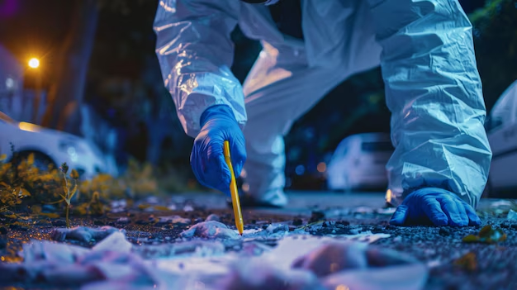
What is Forensic Science?
Definition:
The application of scientific technology to supply accurate and objective information reflecting the events that occurred at a crime
Or
The application of scientific knowledge to legal problems.

Slide 16
Before providing a short description of the forensic disciplines, it is necessary to discuss THREE CONCEPTS that are important in all forensic sciences.
Chain of Custody:
The first involves maintaining the proper “chain of custody” when dealing with evidence.
Evidence of whatever type must be carefully and properly documented and evaluated. Because of the nature of certain types of evidence, it cannot all be collected and preserved indefinitely.
Maintaining a proper “chain of custody” involves producing and maintaining written documentation that accompanies the evidence and provides an uninterrupted timeline showing the secure location of the evidence from the time that it was discovered until the present time.
Any transfer of evidence from one person or secure location to another must be documented. Maintaining this chain of custody helps to ensure that the evidence has not been contaminated or compromised in any way.
If the proper “chain of custody” is not maintained, the breaking of the chain may well provide a potential reason for such evidence to be inadmissible in court.

Slide 17
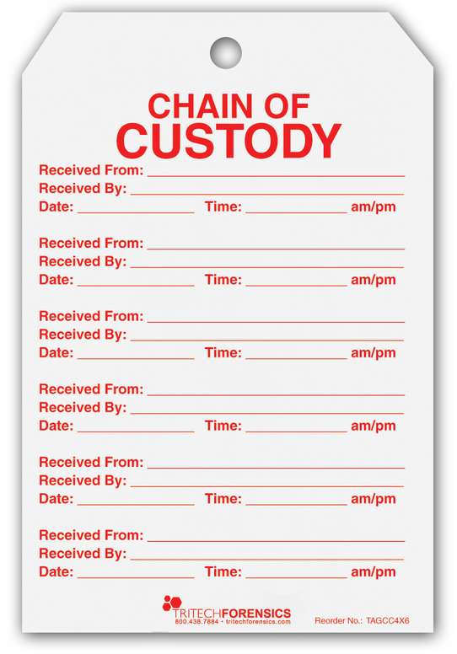
What the Chain of Custody entail in Digital Cyber Forensics?
The chain of custody in digital cyber forensics is also known as the paper trail or forensic link, or chronological documentation of the evidence.
Chain of custody indicates the collection, sequence of control, transfer and analysis.
It also documents details of each person who handled the evidence, date and time it was collected or transferred, and the purpose of the transfer.
It demonstrates trust to the courts and the client that the evidence has not tampered.
Digital evidence is acquired from a myriad of devices like a vast number of IoT devices, audio evidence, video recordings, images, and other data stored on hard drives, flash drives, and other physical media.

Slide 18
Importance of Maintaining Chain of Custody?
Importance to Examiner:
To preserve the integrity of the evidence.
To prevent the evidence from contamination, which can alter the state of the evidence.
In case you obtained metadata for a piece of evidence but were unable to extract any meaningful information from the metadata. In such a case, the chain of custody helps to show where possible evidence might lie, where it came from, who created it, and the type of equipment used. This will help you to generate an exemplar and compare it to the evidence to confirm the evidence properties.
Importance to the Court:
If not preserved, the evidence submitted in the court might be challenged and ruled inadmissible.

Slide 19
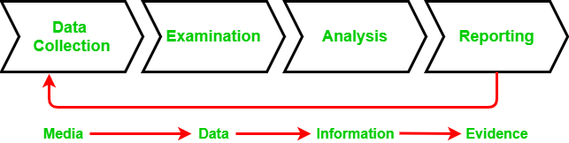
Chain of Custody Process
To preserve digital evidence, the chain of custody should span from the first step of data collection to examination, analysis, reporting, and the time of presentation to the Courts. This is very important to avoid the possibility of any suggestion that the evidence has been compromised in any way.
Each stage of the chain of custody in detail:
Data Collection: This is where the chain of custody process is initiated. It involves identification, labelling, recording, and the acquisition of data from all the possible relevant sources that preserve the integrity of the data and evidence collected.
Examination: During this process, the chain of custody information is documented outlining the forensic process undertaken. It is important to capture screenshots throughout the process to show the tasks that are completed and the evidence uncovered.

Slide 20
Chain of Custody Process
Analysis: This stage is the result of the examination stage. In the Analysis stage, legally justifiable methods and techniques are used to derive useful information to address questions posed in the particular case.
Reporting: This is the documentation phase of the Examination and Analysis stage. Reporting includes the following:
Statement regarding Chain of Custody.
Explanation of the various tools used.
A description of the analysis of various data sources.
Issues identified.
Vulnerabilities identified.
Recommendation for additional forensics measures that can be taken.

Slide 21
The Chain of Custody Form
To prove a chain of custody, a form that lists out the details of how the evidence was handled every step of the way is needed. The form should answer the following questions:
What is the evidence?: For example - digital information includes the filename, md5 hash, and Hardware information includes serial number, asset ID, hostname, photos, and description.
How did you get it?: For example - Information about used tools, type of acquisition (live or offline), storage format or Bagged, tagged or pulled from the desktop.
When it was collected?: Date, Time
Who has handled it?
Why did that person handle it?
Where was it stored?: This includes the information about the physical location in which proof is stored or information of the storage used to store the forensic image.
How do you transport it?: For example - in a sealed static-free bag, or a secure storage container.
How it was tracked?
How it was stored?: For example - in a secure storage container.
Who has access to the evidence?: This involves developing a check-in/ check-out process.
The CoC form must be kept up-to-date. This means every time the best evidence is handled, the chain of custody form needs to be updated.

Slide 22
Procedure to establish the Chain of Custody
In order to assure the authenticity of the chain of custody, a series of steps must be followed. It is important to note that the more information Forensic expert obtains concerning the evidence, the more authentic is the created chain of custody. You should ensure that the following procedure is followed according to the chain of custody for electronic devices:
Save the original material.
Take photos of the physical evidence.
Take screenshots of the digital evidence.
Document date, time, and any other information on the receipt of the evidence.
Inject a bit-for-bit clone of digital evidence content into forensic computers.
Perform a hash test analysis to authenticate the working clone.

Slide 23
Admissibility of Tests, Evidence and Testimony:
The second issue of concern that crosses all fields of forensic science involves the existence of legal standards for the admissibility of forensic tests and expert testimony.
One legal standard for the admissibility of a forensic test is Frye vs. United States, which states that the forensic technique in question must have “general acceptance” by the scientific community.
Expert Witness:
The third issue that relates to all forensic science disciplines is the concept of the expert witness.
In contrast to a “fact witness,” who is usually only able to relate the facts of the issue at hand as he/she observed them, an “expert witness,” because of his/her specific expertise within a particular discipline, is also able to offer opinions regarding issues that relate to the specific discipline.
To be recognized as an expert witness, the witness must be officially qualified, or recognized as an expert, by the court.

Slide 24
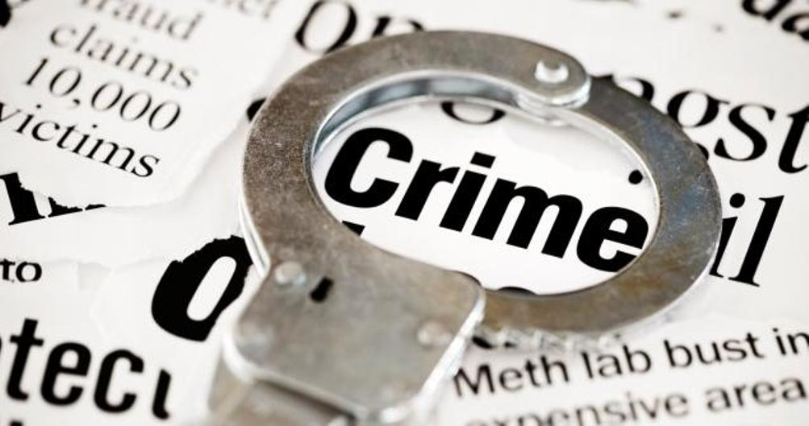
What Is Crime?
Crime is defined as:
An act deemed as socially harmful or dangerous that is specifically defined, prohibited, and punished under criminal law.

Slide 25
CORPUS DELICTI “Body of the Crime”
You must prove:
that a crime occurred.
that the person charged with the crime was responsible for the crime.
Top Reasons for Committing a Crime –
Money
Revenge
Sex
Emotion--love, hate, anger

Slide 26
MODUS OPERANDI “Mode of operating”
Modus operandi (MO) is a Latin term that means method of operating. It refers to how a crime has been committed. It is comprised of acts and decisions that are necessary to commit a crime and any related choices made by an offender.

Slide 27
The application of Forensic Science at the crime scene
The application of Forensic Science in the investigation of crime can be effective only if the investigating officer (IO) knows:
What are the evidences found?
Where they could/would be found?
How it is collected and packed?
What type of standard samples for comparison purposes are necessary?
How much sample is required?
How the sampling is done?
How the packaging is done?
How the evidence will link with the crime and with the criminal?

Slide 28
History & Development of Forensic Science
a) Mathieu Orfila (1787-1853), Spanish-born but did work in France.
Father of Forensic Toxicology.
In 1814, he published a Treatise on the Detection of Poisons.
b) James March (1836) – he was the first to develop a test for identifying Arsenic Poisoning.
c) Alphonse Bertillon (1853-1914), French Scientist.
In 1879, he devised the first system of a person’s ID using a series of body measurements.
Devised the first crime scene kit – still used today.
The Bertillon system relied on a detailed description and measurement of the subject – Anthropometry (head length, head breadth, length of the middle finger, length of the left foot, and length of the cubit).
d) Francis Galton (1822-1911), British Scientist.
In 1892, he published the book “Fingerprints” which contained the 1st statistical proof supporting the uniqueness of fingerprints.
Laid the foundation of modern fingerprints.
e) Karl Landsteiner (1868-1943), Austrian, immigrated to the U.S.
1901: Discovered human blood could be grouped into different categories (A, B, AB, and O).
1930: Won Nobel Prize.
1940: Helped to discover the Rh factor in human blood.

Slide 29
f) Leone Lattes (1887-1954), Italian Scientist.
1915: devised a procedure by which dried bloodstains could be grouped as A, B, AB, or O (by using the diluted isotonic solution of NaCl).
His procedure is still used today by some forensic scientists.
g) Calvin Goddard (1891-1955), U.S. Army colonel.
Developed the Comparison Microscope.
Refined the techniques of determining if a gun had fired a specific bullet (Ballistics).
h) Albert S. Osborn (1858-1946), American Scientist.
1910 published the book “Questioned Documents.”
The book became a primary reference for document examiners.
i) Hans Gross (1847-1915), Lawyer and Judge in Austria.
1893: Published the first treatise on applying science to criminal investigation.
Started the forensic journal “Kriminologie”.
j) Edmond Locard (1877-1966), 1910 set up the first Forensic Lab in Lyons, France.
Founder and Director of the Institute of Criminalistics @ the University of Lyons.
Formulated the Locard’s Exchange Principle.

Slide 30
Reference of investigative methods is found in Kautilya’s “Arthashastra” about 2300 years old.
Indians studied patterns of papillary lines, thousands of years back.
Chemical Examiner’s Lab: Set up first at the Madras Presidency, Dept. of Health, 1849 followed by Calcutta (1853), Agra (1864) & Bombay (1870).
Anthropometric Bureau: established in 1892 at Calcutta.
5. Finger Print Bureau: The first one in the world at Calcutta, July 1897.
Willian Herschel, Collector of the District of Hooghly, found that the FPs never changed in a lifetime. He applied this knowledge in the registration of thumb/finger impressions of the natives. This registration was then extended to convicted criminals in prisons as well. However, his ideas were not given consent. In 1891, Edward Richard Henry, IGP, Bengal, introduced the thumb impressions in the record slips containing Anthropometric data. Khan Bahadur Azizul Haq and Rai Bahadur Hem Chandra Bose worked under him. Azizul Haq evolved a mathematical formula to supplement Henry’s idea of sorting slips in 1024 pigeon holes, based on fingerprints. Hem Chandra Bose developed an extended system of sub-classification.

Slide 31
6. Department of Explosives: The foundation for the Dept was laid when the first Inspector of Explosives was appointed in 1898 with its HQs at Nagpur and 5 regional offices at Calcutta, Bombay, Agra, Madras & Gwalior and 3 sub-offices at Shivkashi, Gomia, & Asansol.
7. Govt Examiner of Questioned Document: The British Govt of Bengal created the post of govt handwriting expert of Bengal. Mr C.R. Hardless, the then superintendent in the A.G’s office in Bengal was appointed for this post in 1904. This was shifted to Shimla in 1906, under the control of the Director, CID. Mr. C.R. Hardless was appointed as the Handwriting Expert for Govt of India. Later he was replaced by Mr. F. Brewester, a police officer from WB, CID and was designated as the Government Examiner of Questioned Documents (GEQD).
8. Serologist to the Govt of India: Serology Department was established in Calcutta in 1910. The HoI was designated as the Imperial Serologist to the Govt. of India.
9. Footprint Section of Criminal Investigation Dept: In 1915, a Footprint Section was established under the CID, Govt of Bengal.
10. Note Forgery Section in Criminal Investigation Dept.: In 1917, a Note Forgery Section was set up under the CID, Govt of Bengal for examination of forged currency notes. The Revenue Dept. was set up for identification of opium, narcotics, precious metals, etc. Govt. Mint and Security Printing Dept. at Nasik was set up for detecting Counterfeit and forged currency.
11. Ballistics Laboratory: In 1930, an Arms Expert was appointed and a Ballistics laboratory was set up a under the Calcutta Police.

Slide 32
Evolution of FSL’s
There are 3 types of Forensic Science Laboratories (FSLs) in India:
Central Forensic Science Laboratories (CFSLs)
State Forensic Science Laboratories (SFSLs)
Regional Forensic Science Laboratories (RFSLs)
First FSL was established in Calcutta (1952) - Medico-legal Section of the Chemical Examiner’s Laboratory, Physics Section, Footprint and Note Forgery Sections of CID were transferred here, Chemistry Section of CEL was also transferred here.
Second FSL was established in Bombay (1958) - It has 5 regional labs at Nagpur, Aurangabad, Pune , Nasik, & Amravati.

Slide 33
CFSL and other Central Institutes
Central Finger Print Bureau: Established in 1905 in Shimla but abolished in 1922. The CFPB restarted from 1955 in Delhi under the purview of IB. In August 1956, it was shifted to Calcutta. In Sept 1973 it was transferred to the CBI from IB. In July 1986, it came under the purview of NCRB and was shifted to ND.
Central Detective training School at Calcutta: Was established in 1956 in Calcutta.
CFSLs: First CFSL – Calcutta (1957) and Second CFSL – Hyderabad (1965).

Slide 34
Forensic Science: Functions
Forensic science provides answers to the following three questions:
1. Has a crime been committed?
Consider the case of recovery of a dead body. Death could be natural, accidental or homicidal. By ascertaining the nature of death, it can be established the existence or absence of corpus delicti.
2. How and when was the crime committed?
The examination of the corpus delicti reveals the way the crime was committed and possibly the time when it was committed.
3. Who has committed the crime?
Forensic science establishes the identity of the culprit through personal clues like fingerprints, footprints, blood drops or hair. It links the criminal with the crime through the objects that have been left by him at the scene with the victim or which have been carried from the scene by the victim.

Slide 35
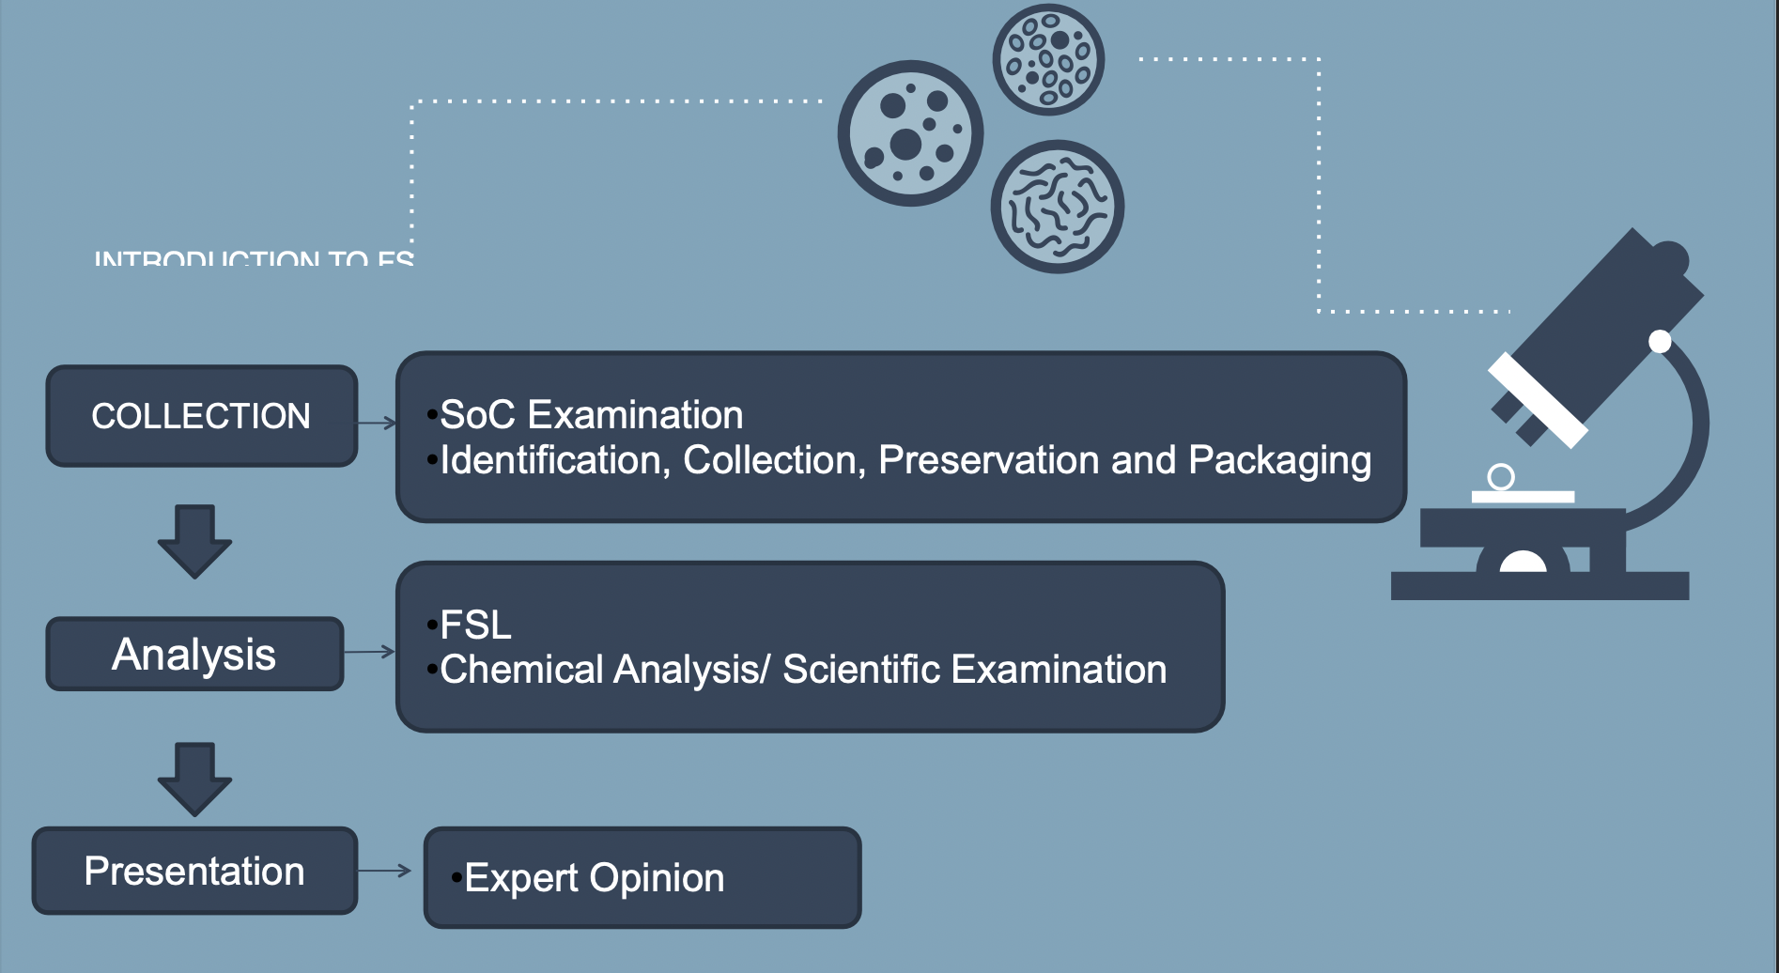
Forensic Scientist

Slide 36
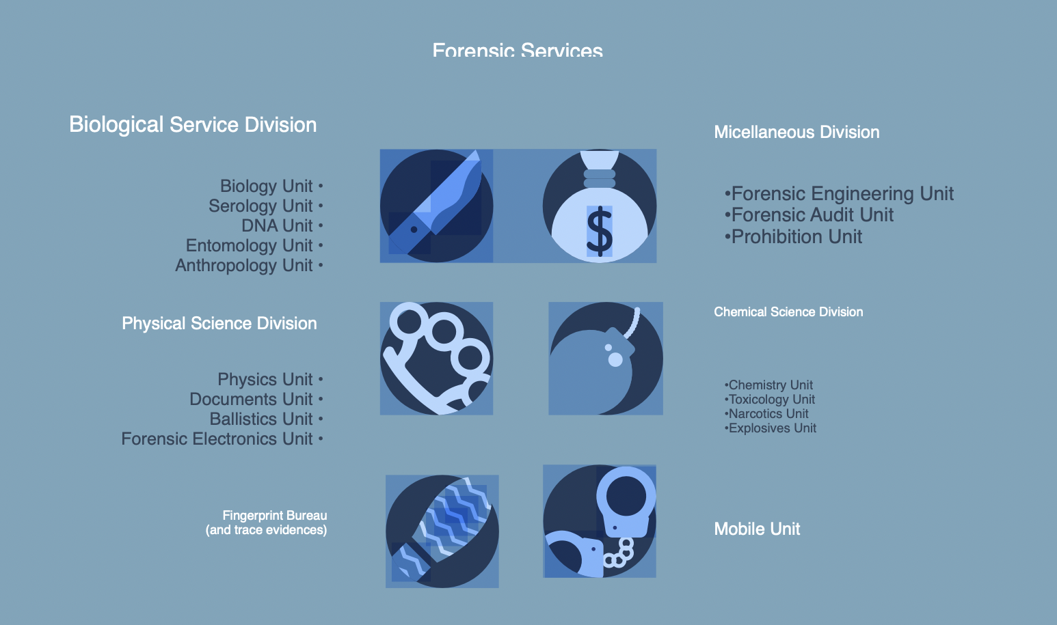

Slide 37
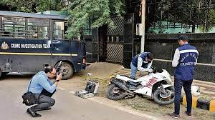
Divisions of Forensic Science Laboratory
An ideal Forensic Science Laboratories is generally divided into the following divisions:
Photography (Common for all the divisions)
Identification of camera from film negatives
Identification of Source camera
Preparation of photographs
Crime Scene Photography
Post Mortem Photography/Videography

Slide 38
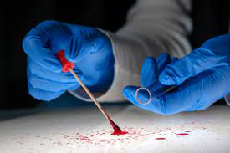
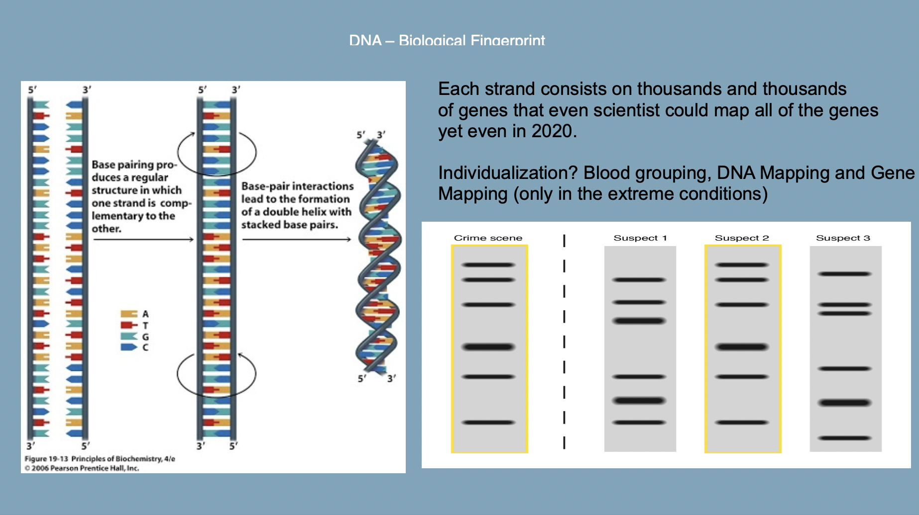
2. Biological sciences, which includes, Biology Unit/ Serology Unit/ DNA Unit:
The Forensic Biology/DNA Unit uses high-quality technology and scientific processes to detect, collect, and interpret the results from biological evidence.

Slide 39
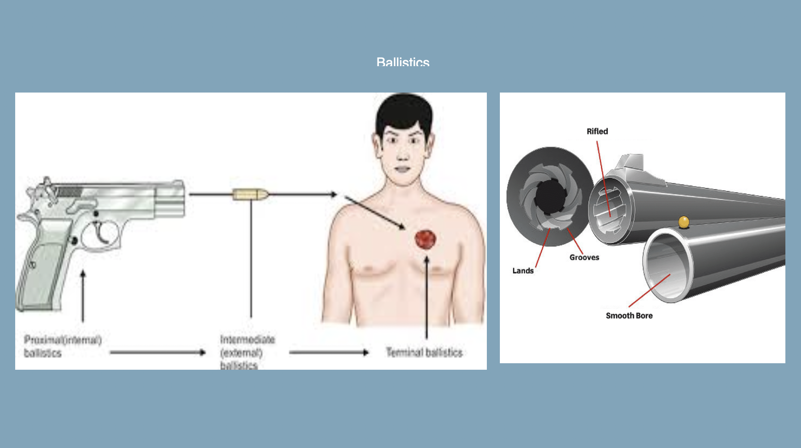
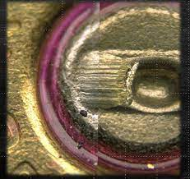
3. Ballistics Division:
The Ballistics division undertakes the following examinations: Examination for serviceability/working condition of firearm (pistol & revolver). Examination for serviceability of ammunition (handgun/rifle). Determination of type, make and calibre of unfired cartridge/fired cartridge case.

Slide 40
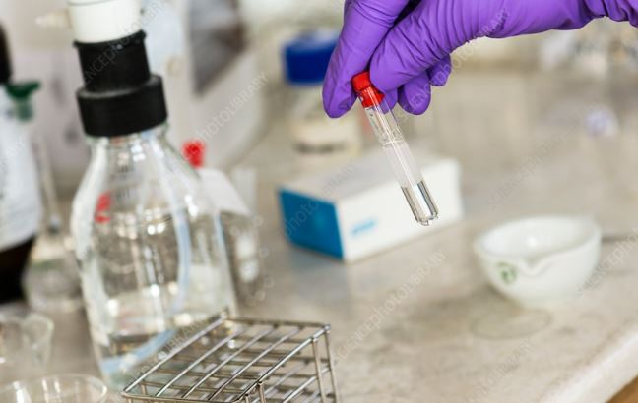
4. Chemical Sciences Division:
Undertakes examination of exhibits like Explosive Residues, Acid, Precious Stones, Metal, Liquor etc. ND&PS substances like Heroin, Ganja, Brown sugar, Opium etc.
Chemistry Unit
Toxicology Unit
Narcotics Unit
Explosive Unit

Slide 41
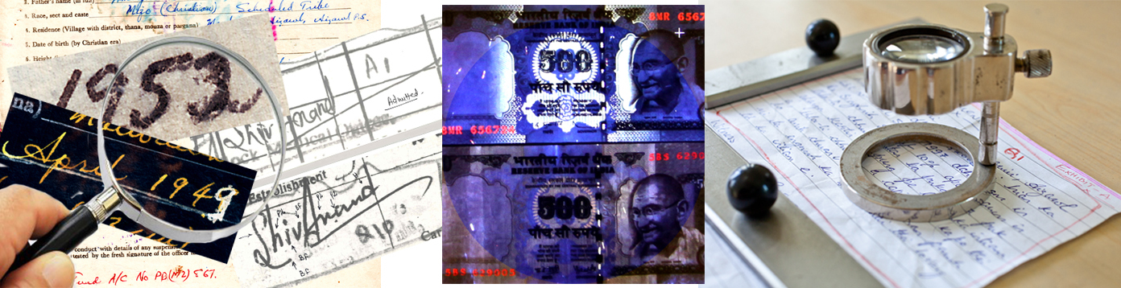
5. Documents Division:
Handwriting & Signatures – To examine/compare with standard (admitted & specimen) writings.
Latent Writing on Documents – To detect and decipher.
Fake Indian Currency Notes of Different Denomination – To examine presence of security/essential features prescribed by RBI.
Printed matter – To examine/compare with standard ones.
Stamp Impression – To examine/compare with the standard stamped impression.
Erasing, Alteration, Overwriting etc. – To detect and decipher such features on questioned documents.
Fake documents, stamps, stamp papers, security papers – To ascertain genuineness.

Slide 42
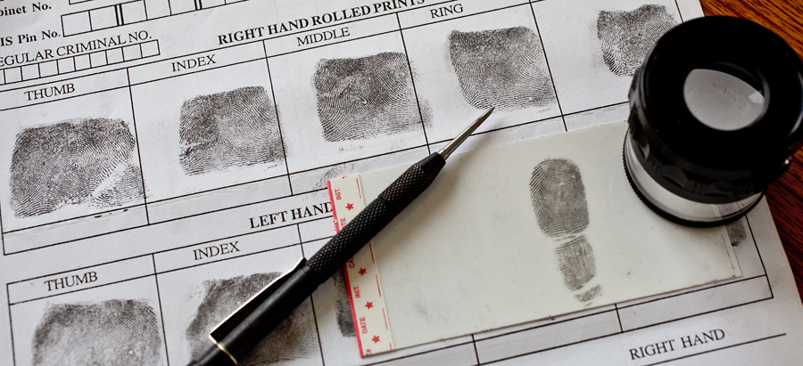
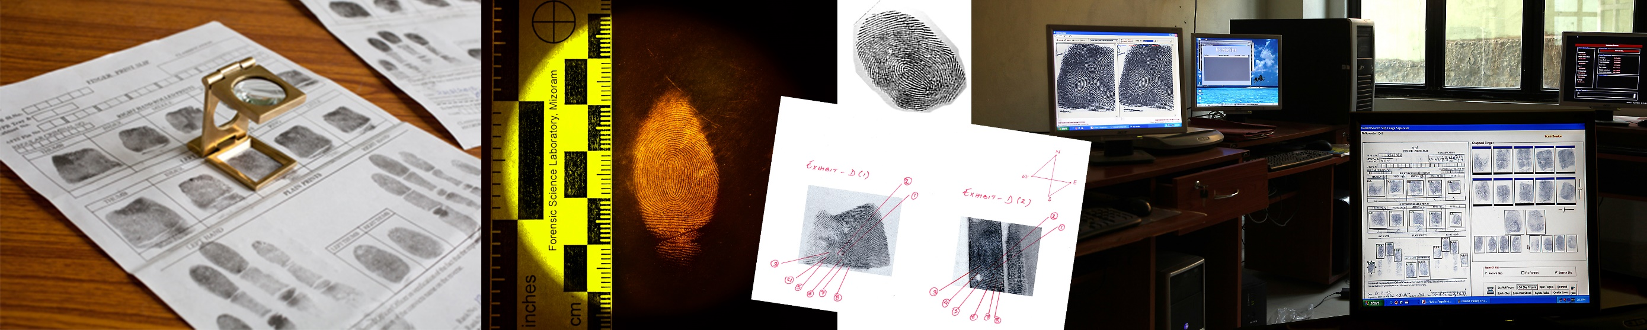
6. Fingerprint Division:
Maintaining fingerprint record slips.
Conducting Fingerprint search.
Undertaking examination of Questioned Fingerprint impression on documents.
Examining and comparing the chance prints.
Developing latent prints.
Examining unidentified dead bodies in establishing identity with available fingerprints on record.

Slide 43

7. Cyber Division: Deals with –
Disk Forensics: Extraction and analysis of data from Computer hard disks, USB devices, floppy, CD, DVD, and Flash drives.
Mobile Device Forensics: Extraction and analysis of data from handheld devices like mobile phones, Smartphones, tablets, etc.
Memory Forensics: Analysis of volatile data in a computer’s memory dump.
Network Forensics: Monitoring and analysis of computer network traffic.
Multimedia Forensics: Analysis of multimedia signals (audio, videos, images.
Internet Forensics: Tracking and analysis of e-mails, social media, websites, and cloud storage.
Cryptocurrency Forensics: Tracking of cryptocurrency transactions through thousands of social media forums and Darknet sites.
Forensic Field Kit

Slide 44
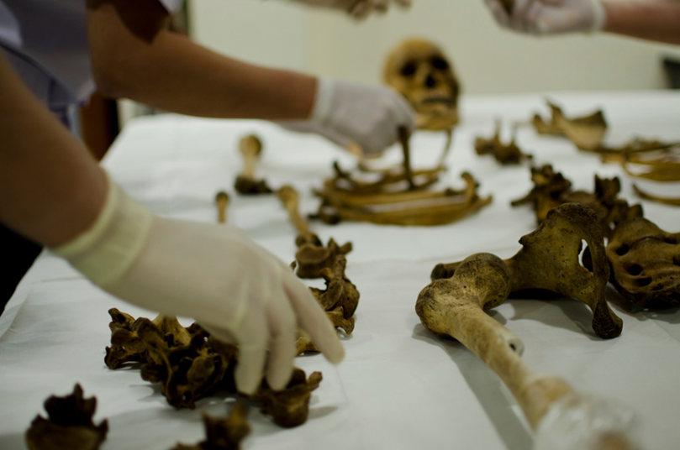
8. Medico-legal Division:
Forensic Medicine (Postmortem and antemortem Investigation, Victim and criminal’s body assessment, etc.)
Forensic Toxicology (Poisons and their effects)
Forensic Pathology (Tissue study- Mostly post-mortem)
Mass Disaster Management

Slide 45
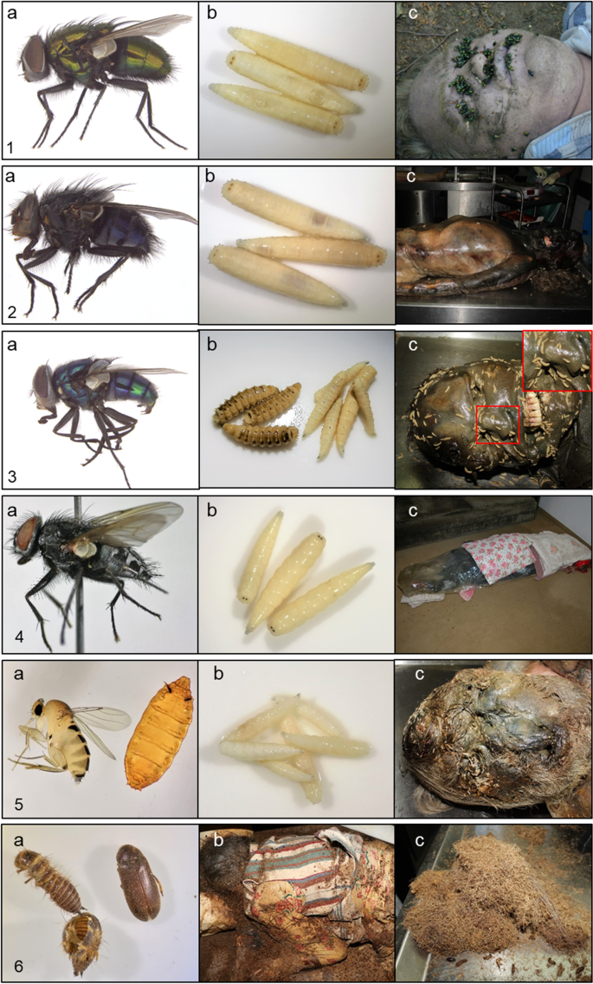
9. Entomology Division:
The study of the application of insects and other arthropods in the criminal investigation.
Insects or arthropods are found in a decomposing vertebrate corpse or carrion.

Slide 46
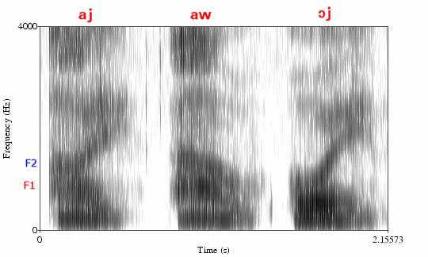
10. Audio Forensics:
Audio forensics is the field of forensic science relating to the acquisition, analysis, and evaluation of sound recordings that may ultimately be presented as admissible evidence in a court of law or some other official venue.
Sound spectrograph developed using the instrument, Audio Spectrogram, between the control and test samples

Slide 47

11. Video Forensics:
Forensic video analysis is the scientific examination, comparison, and/or evaluation of video in legal matters.
The video forensic process must be performed in a forensic lab that is equipped with the appropriate tools and follows best practice protocols in order to process the video recording with integrity and accuracy.

Slide 48
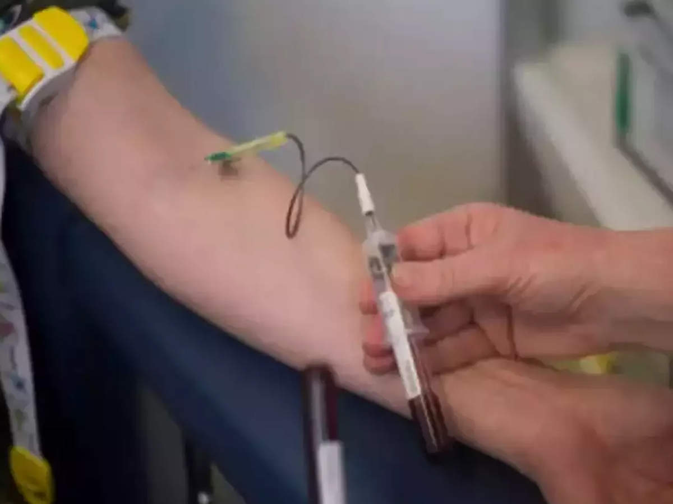
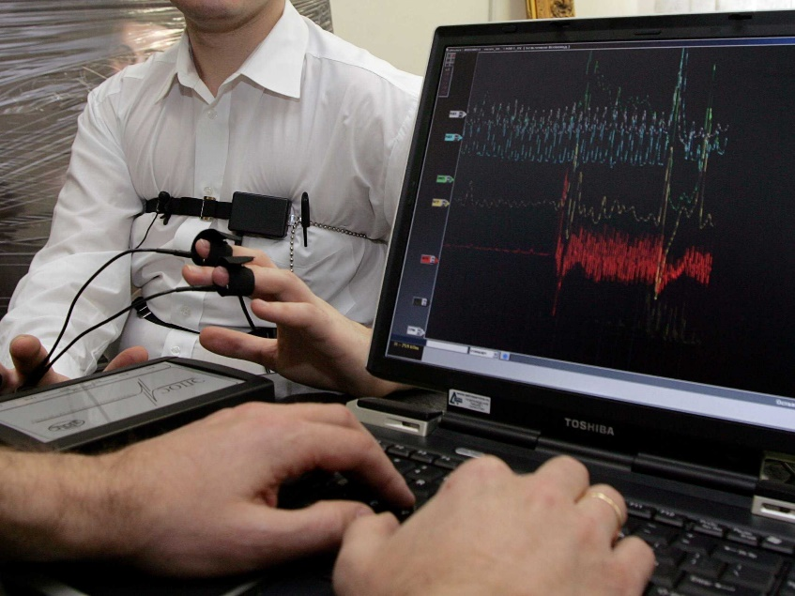

11. Psychology Division
Psycho-physiological detection of deception (PDD) (Lie detection)
Narco-analysis
Brain Fingerprinting
Criminal Profiling

Slide 49
Psycho-physiological detection of deception (PDD) (Lie detection) - Originating from the Polygraph, lie detection based on sophisticated measures of Bio-feedback and continuous recording of minor variations on complex computer programs, provides a whole range of instruments. The basic principle is to provide psychologically arousing cues intermittently while monitoring the changes using pulse, temperature, respiration, skin conductivity, or any other physiological measure. In this process, an individual trying to mislead by providing untrue information can be identified.
Narco-analysis- In this analysis, the subject's imagination is neutralized by making him semi-conscious. In this state, the person cannot lie to any question. Experts inject the subject with intravenous hypnotic medications like Sodium Pentothal or Sodium Amytal. The dose is dependent on the person's sex, age, health, and physical condition. This process too cannot be conclusive without the active role of a forensic psychologist.

Slide 50
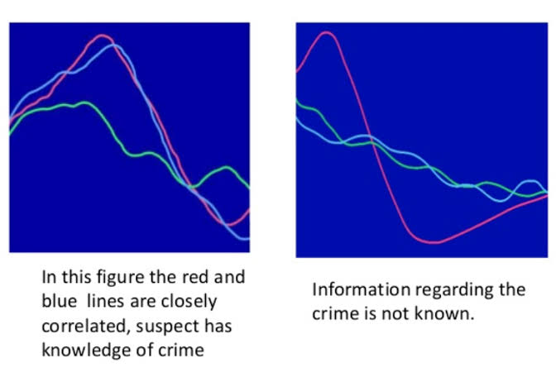
Brain Fingerprinting - Brain fingerprinting is a forensic science technique that uses electroencephalography (EEG) to determine whether specific information is stored in a subject's brain by measuring electrical brainwave responses to words, phrases, or pictures that are presented on a computer screen.

Slide 51
Criminal profiling- It is profiling the offender based on clinical/psychological analysis of the consistent behavioural and personality features. After an in-depth accurate understanding of the psycho-social functioning, a profile is created which assists in predicting the characteristics of unknown criminal subjects or offenders, thus, leading to apprehending them.
Aim of Criminal Profiling:
To help the investigators in identifying an unknown criminal from the profile.
To indicate a psychological portrait of the subject (criminal).
To understand the criminal’s pattern, the type of evidence they can expect from the SOC and type of interrogation method they can use in the investigation process.

Slide 52
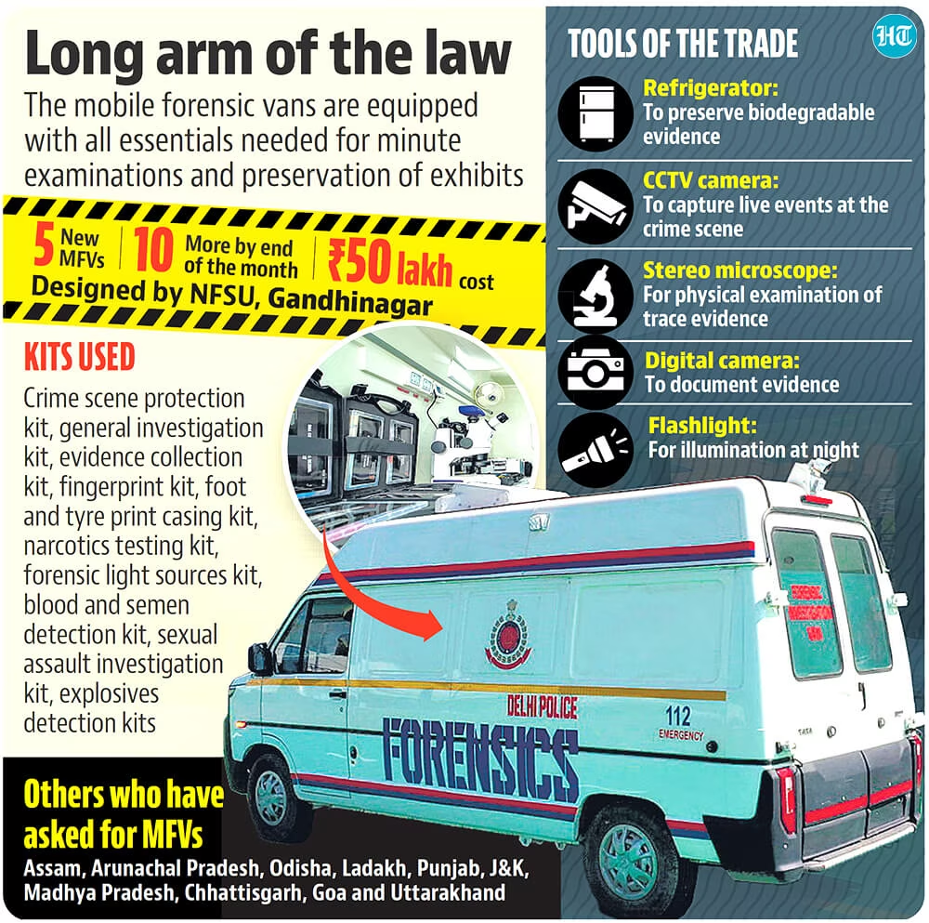
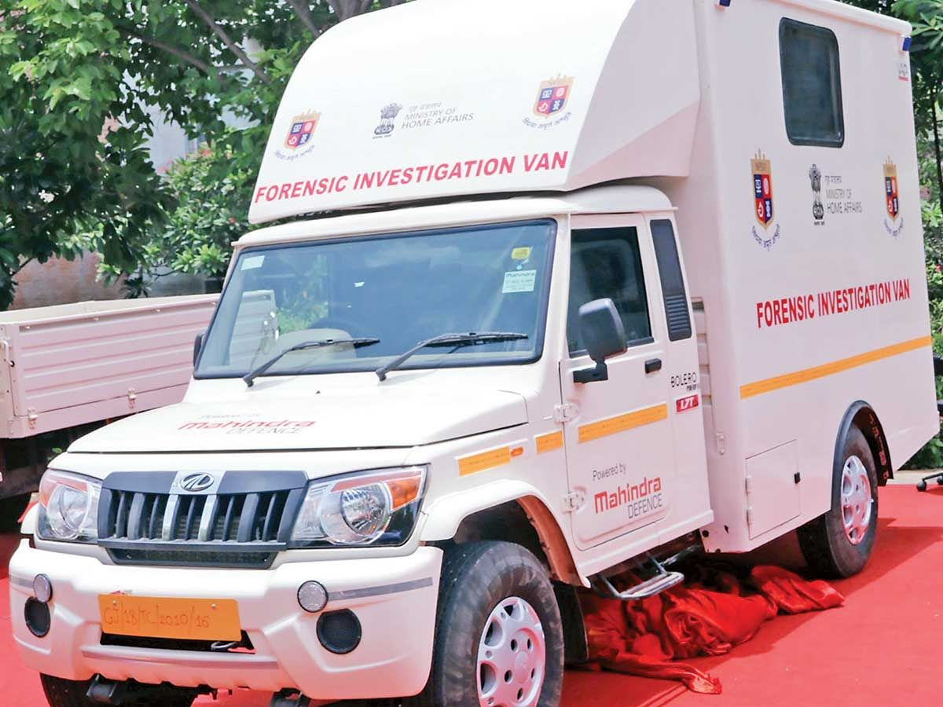
Field Units or Mobile Laboratory (Mobile Van) - Helps reach the crime scene at the earliest as to aid the investigation officers in the proper preservation, collection, packaging, and transportation of all the relevant evidence present at the scene of crime.

Slide 53
Short Summary
Forensic Science is the application of science to criminal and civil laws that are enforced by police agencies in a criminal justice system.
The first system of personal identification was called anthropometry. It distinguished one individual from another based on a series of bodily measurements.
Locard’s exchange principle states that, when two objects come into contact with each other, a cross-transfer of materials occurs that can connect a criminal suspect to his or her victim.
A forensic scientist must be skilled in applying the principles and techniques of the physical and natural sciences to analyzing evidence that may be recovered during a criminal investigation.
The cases Frye v. United States and Daubert v. Merrell Dow Pharmaceuticals, Inc. set guidelines for determining the admissibility of scientific evidence into the courtroom.
Forensic scientists participate in training law enforcement personnel in the proper recognition, collection, and preservation of physical evidence.

Slide 54
Thank you

